Slide 1


Car Resale Value Prediction
Mentor:
Ms. Suhasini.C M.E.,
Assistant Professor,
Dept. of Information Technology
Rathinam Technical Campus,
Coimbatore – 641 021.
Team Members:
Avinashlingam S .(721819104003)
Mohammad Jameal J .(721819104013)
Mohammed Nishar S(721819104014)
Rohith R V (721819104021)
Dept. of Computer Science and Engineering,
Rathinam Technical Campus,
Coimbatore – 641 021.

Slide 2
Agenda
Objective / Aim of the Project
Introduction
Existing System
Block Diagram of Existing System
Drawbacks of Existing System
Proposed System
Flow Diagram of Proposed System
Implementation of the Project - Screenshots
Conclusion

Slide 3
Objective / Aim of the Project
Car resale value prediction system is made with the purpose of predicting the correct valuation of used cars that helps users to sell the car remotely with perfect valuation and without human intervention in the process to eliminate biased valuation.
This project focuses on building a system that can accurately predict a resale value of the car based on minimal features like kms driven, year of purchase etc. without manual or human interference and hence it remains unbiased
To enable consumers to know the actual worth of their car or desired car, by simply providing the program with a set of attributes from the desired car to predict the car price.

Slide 4
Introduction
In this project we have used different algorithms with different techniques for developing Car resale value prediction systems considering different features of the car.
The system is defined in the python language that predicts the amount of resale value based on the given information. The system works on the trained dataset of the machine learning program that evaluates the precise value of the car
In a nutshell, car resale value prediction helps the user to predict the resale value of the car depending upon various features like kilometers driven, fuel type, powerPS, model, year of registration, gear, damage caused, etc.
This resale value prediction system is made for general purpose to just predict the amount that can be roughly acquired by the user.
Predicting the resale value of a car is not a simple task. It is trite knowledge that the value of used cars depends on a number of factors. The most important ones are usually the age of the car, its make (and model), the origin of the car (the original country of the manufacturer), its mileage (the number of kilometers it has run) and its horsepower. Due to rising fuel prices, fuel economy is also of prime importance.

Slide 5
Existing System
Due to limited data, system only takes into account limited features for predicting the resale value of the car.
Since this is an online system, current system does not take into account any physical damage to the car body or engine while predicting the resale value.
In existing model, it was to estimate the cost of the used cars using the K nearest neighbour algorithm which is simple and suitable for small data set. Here, they have collected a used cars dataset and analyzed the same. The data was trained by the model and examined the accuracy of the model among different ratios of trained and test set.
The same model is cross-validated for assessing the performance of the model using the K- Fold method which is easy to understand and implement. They have used the K nearest Neighbour algorithm and got accuracy 85% where the accuracy of linear regression is 71%.

Slide 6
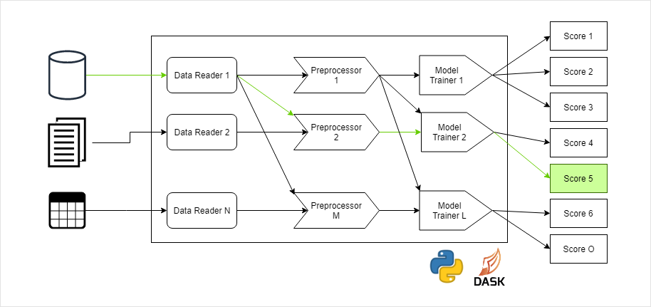
Block Diagram of Existing System

Slide 7
Drawback of Existing System
In the existing the value predicted was up to only a 50% correct because of using old models, which was efficient 5years back.
Such model which was trained is not so efficient in today’s world.
Requires advancement in training the model with a number of Regression techniques, which is done in the proposed system.
The existing system was not user friendly and did not have correct User Interface for the user to enter his/her car details.
Because of lack of an attractive UI, most clients declined to use the model, There were no spaces for entering the user’s required car model details.
The value predicted was correct for some cases and incorrect for some cases, which was a drawback.

Slide 8
Proposed System
This is a supervised learning problem and can be solved using regression techniques. We need to predict the selling price of a car based on the given car's features. Supervised Regression problems require labeled data where our target or dependent variable is the selling price of a car. All other features are independent variables.
Following are some regression algorithms that can be used for predicting the selling price.
Linear Regression
Decision Tree Regressor
Support Vector Regressor
KNN Regressor
Random Forest Regressor

Slide 9
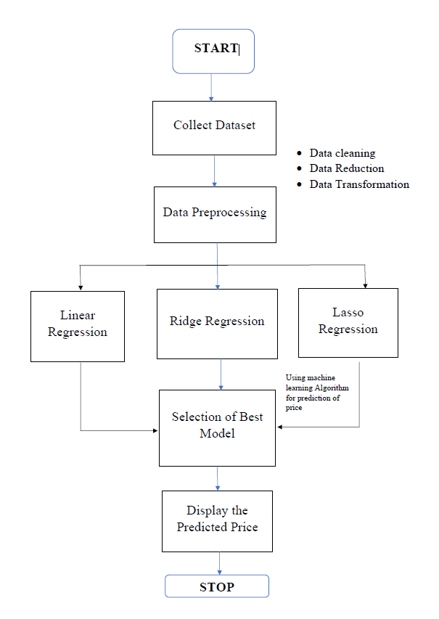
Flow Diagram of Proposed System

Slide 10
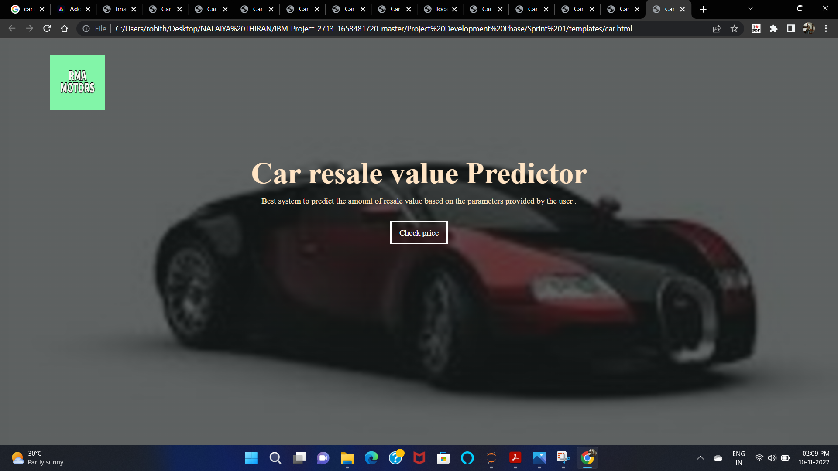
Implementation of the Project - Screenshots

Slide 11
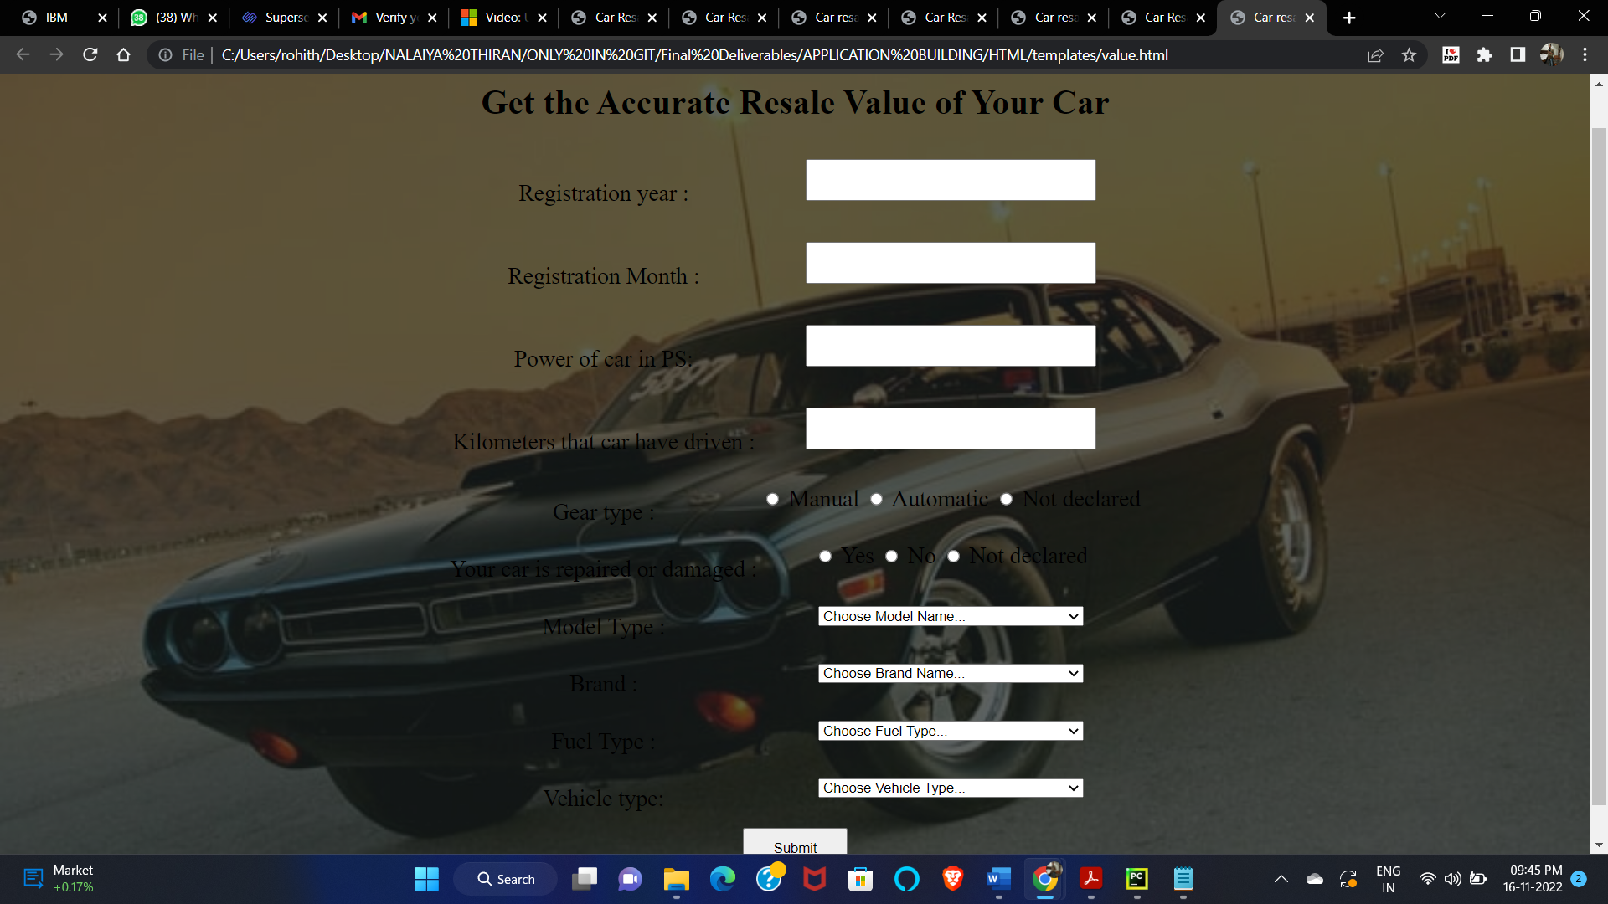
Implementation of the Project – Screenshots (Cont…)

Slide 12
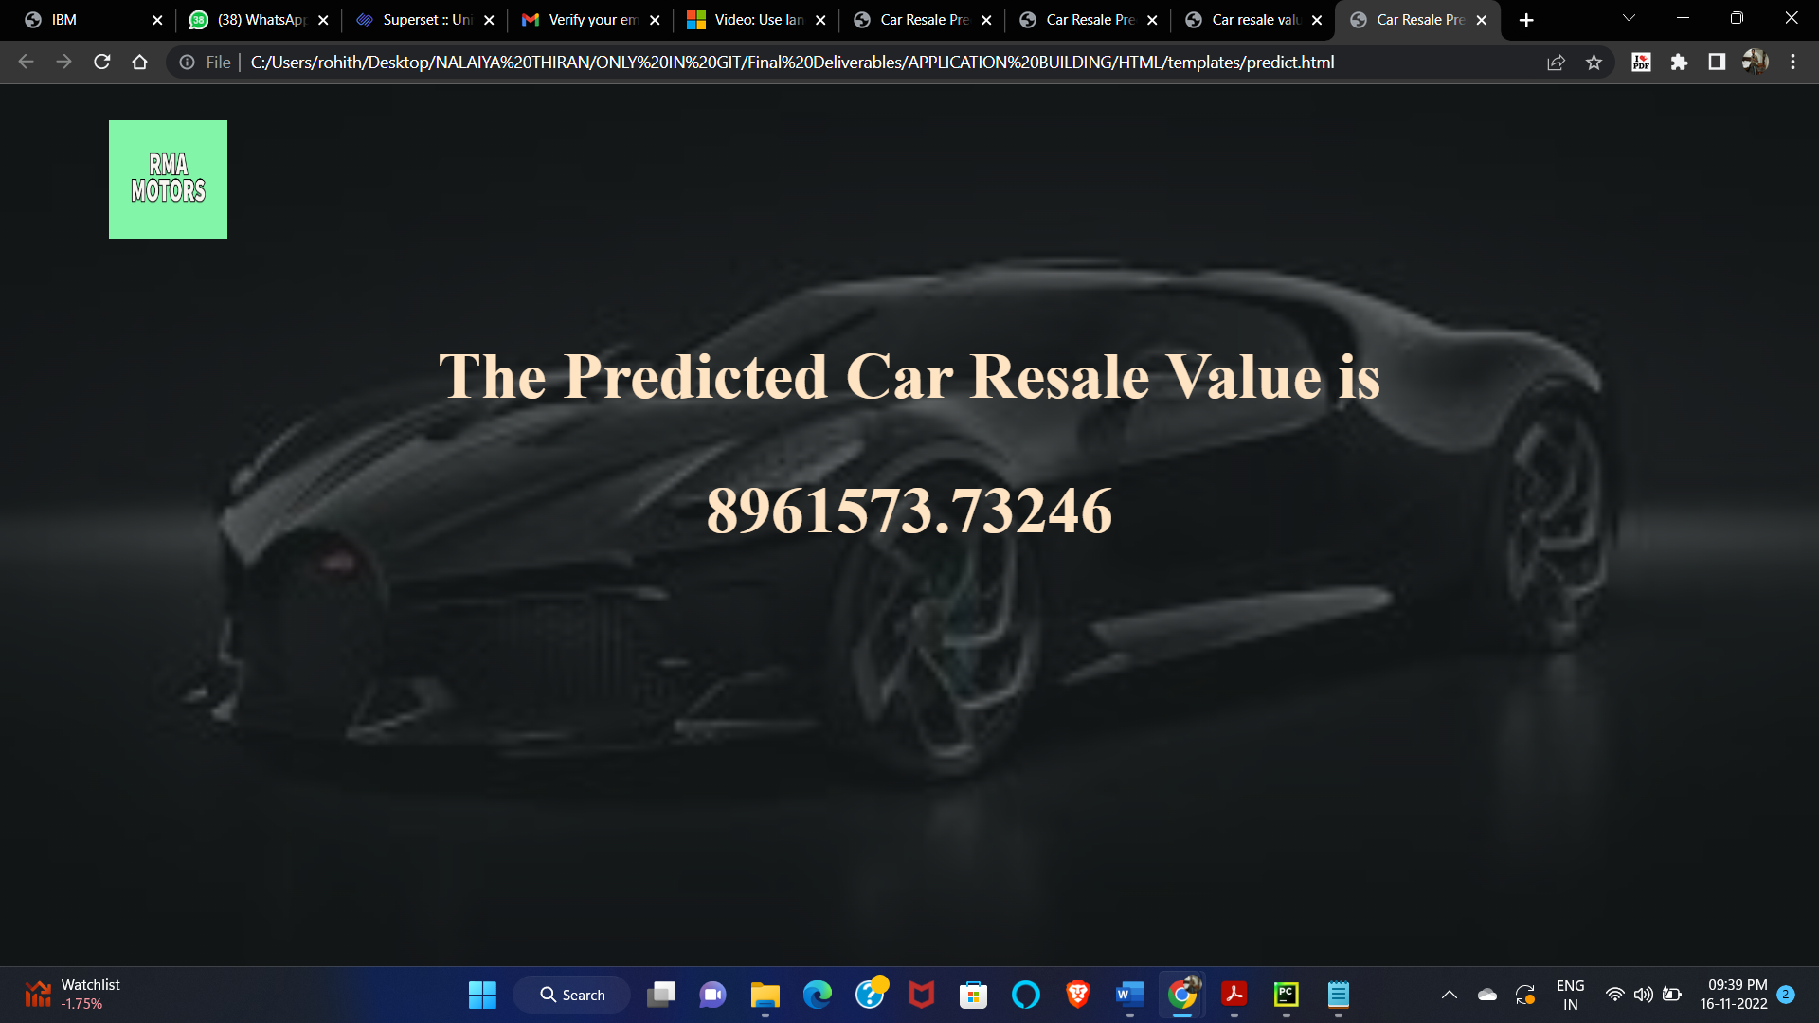
Implementation of the Project – Screenshots (Cont…)

Slide 13
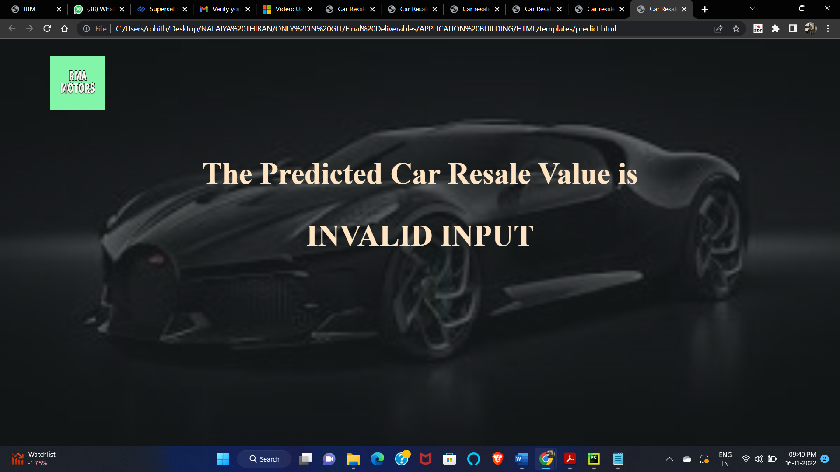
Implementation of the Project – Screenshots (Cont…)

Slide 14
Conclusion and Future Work
Thus, the Random Forest Regressor Regression model trained by us using IBM Watson Studio with the dataset provided by the mentor gives 95% exact resale value of the car
Need to collect more data and develop the dataset and train more in the model for best results and to consider all the models that are present in the real world
In future this machine learning model may bind with various website which can provide real time data for price prediction. Also we may add large historical data of car price which can help to improve accuracy of the machine learning model.
We can build an android app as user interface for interacting with user. For better performance, we plan to judiciously design deep learning network structures, use adaptive learning rates and train on clusters of data rather than the whole dataset.

Slide 15
Thank You!

Slide 16
Any Queries??????????

